Slide 1
Protégé Games
Kevin Carmichael, Tom Lovelette, Cooper Heirakuji, Lourdes Marroquin
Notes:
Note that the students listed who presented each slide in the notes…

Slide 2
Protégé Games
Animation artist
Game Designer 2
Lead Game Designer Lourdes Marroquin
Lead Artist Cooper Heirakuji
Lead Programmer Tom Lovelette
Character
Artist
Sound/ Music Artist
Game Designer
1
Engineer Programmer
Programmer
Producer
Kevin Carmichael
Accountant
QA/Beta Testing
Project Manager
Notes:
Kevin

Slide 3
Company History
Location:
• Los Angeles, California
Previous Games:
• Ball Madness
• Music Revolution
Notes:
Kevin

Slide 4
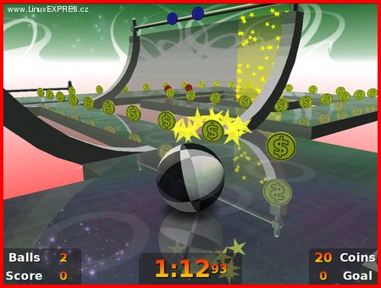
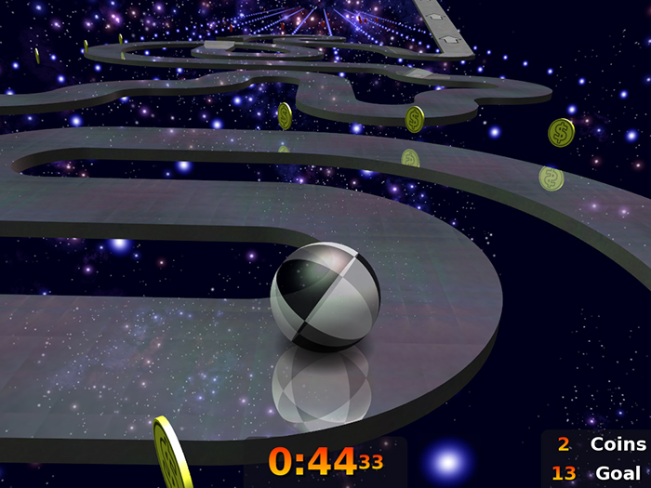
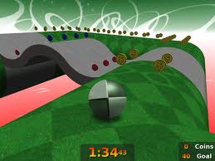
Ball Madness
Genre:
• Puzzle/ Strategy
Platform(s):
• Mobile Devices
Audience:
• G-Rated
Released:
• August 2011
Notes:
• UI setup
Notes:
Tom

Slide 5
Music Revolution
Genre:
• Music/ Karaoke
Platform(s):
• Mobile Devices
Audience:
• Music Enthusiasts/G-Rated
Released:
• August 2012
Notes:
• Song selections
Notes:
Tom

Slide 6
Maze Adventurer
Genre:
• Puzzle/ Skill game
Players:
• Single/Multiplayer
Platform(s):
• iPhone & iPad
Audience:
• G-Rated
Important Dates:
• Pitch: May 2013
• Beta Test: October 2013
• Expected Release : December 2013
Engineering – Unity (iOS)
Maze Adventurer
Notes:
Tom

Slide 7
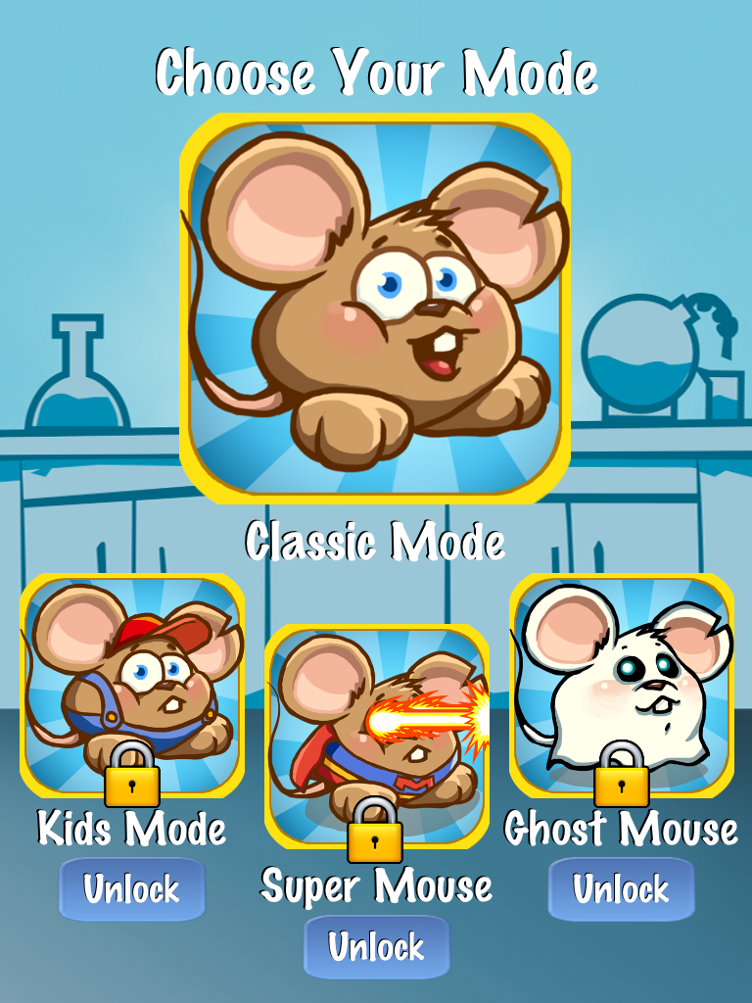
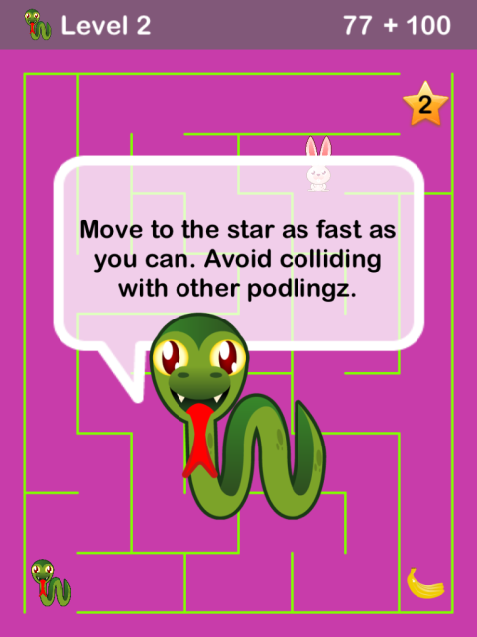
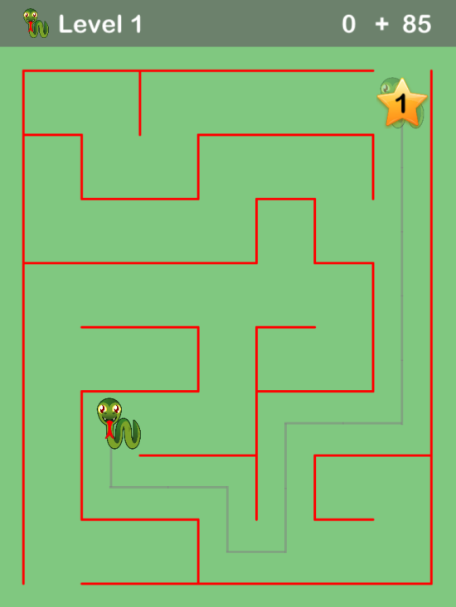
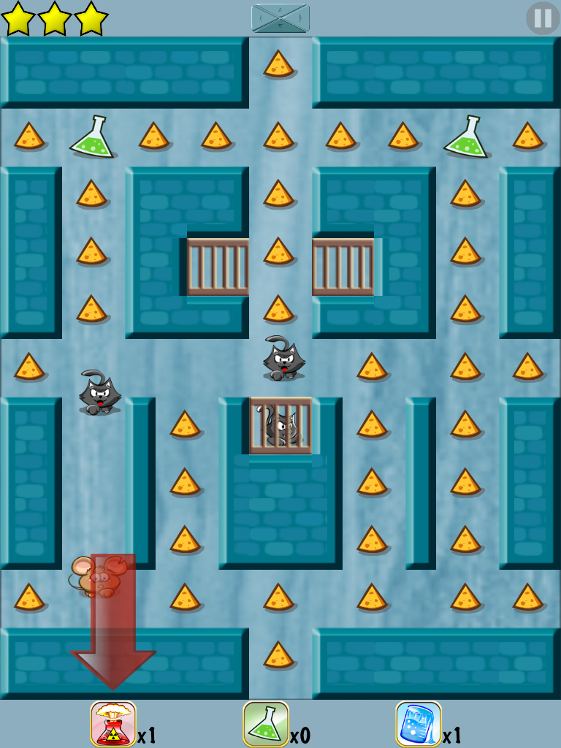
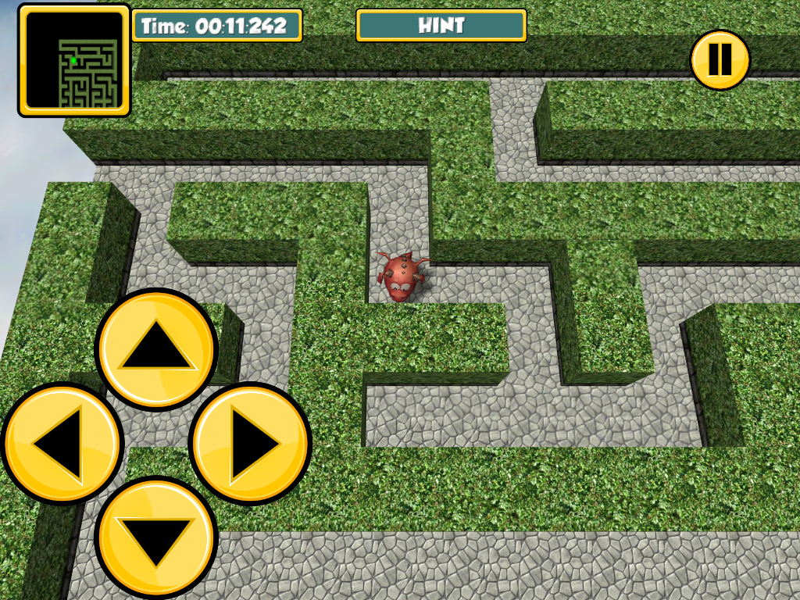
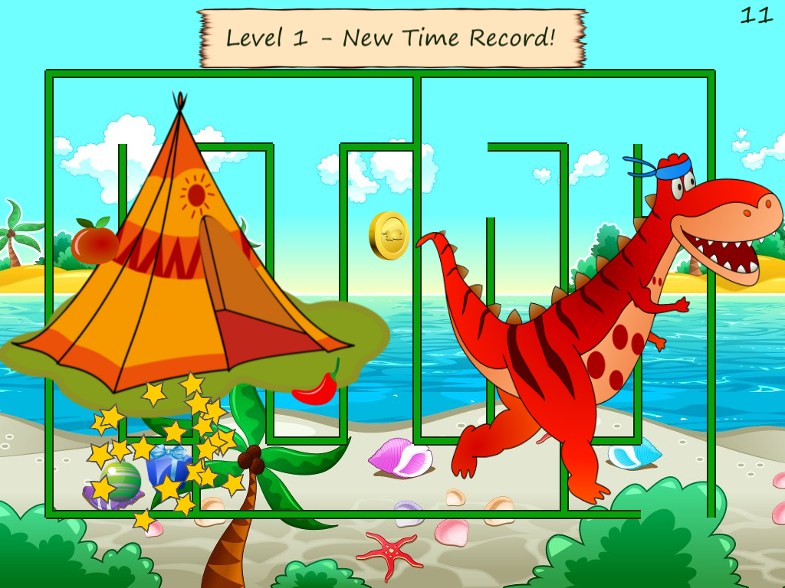
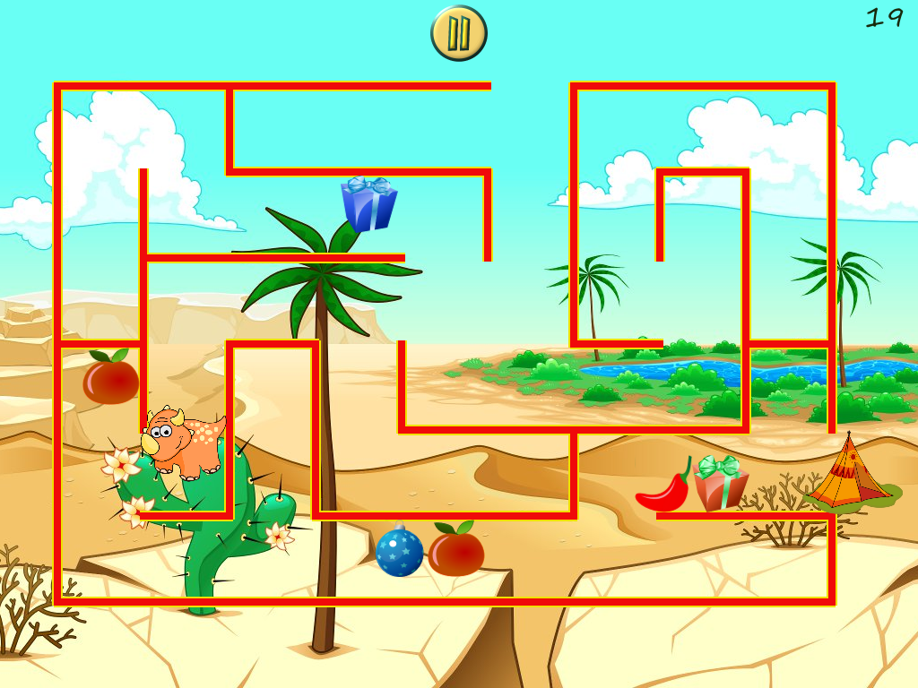
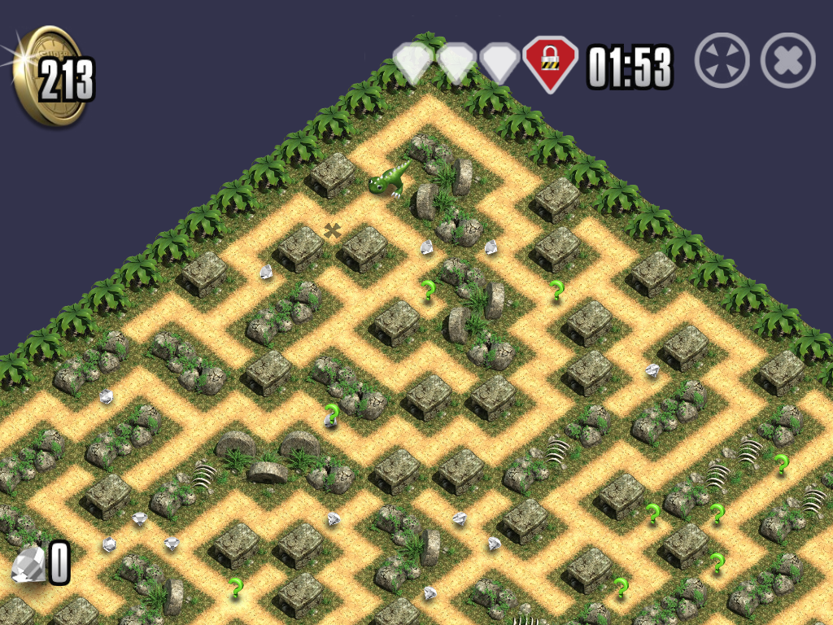
Competition
Maze
Dino Maze
Mouse Maze
Maze 100
SuperMaze3D
Notes:
Tom

Slide 8
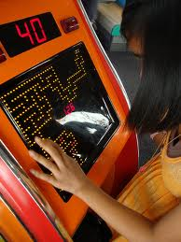
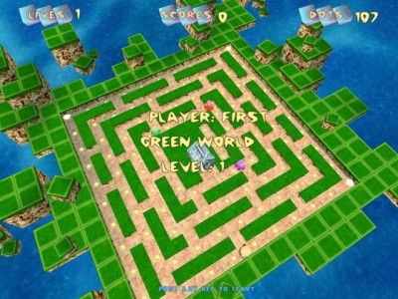
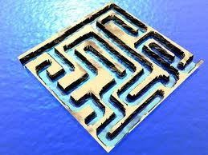
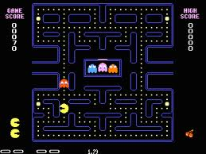
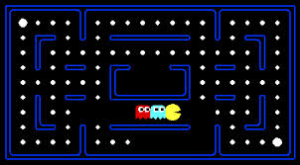
Inspiration
Notes:
Lourdes

Slide 9
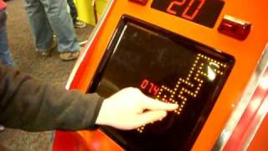
Game Play
Based off Flaming Finger arcade game
Notes:
Lourdes

Slide 10
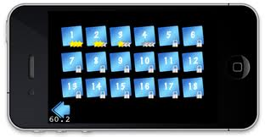
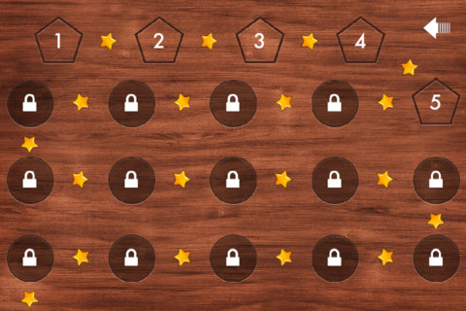
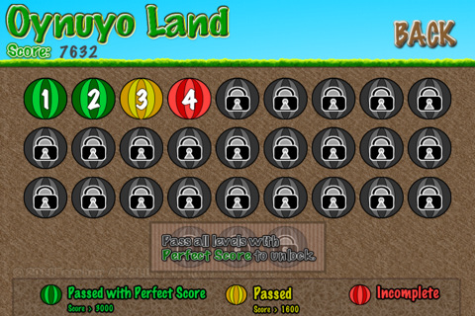
Game Play
Notes:
Lourdes

Slide 11
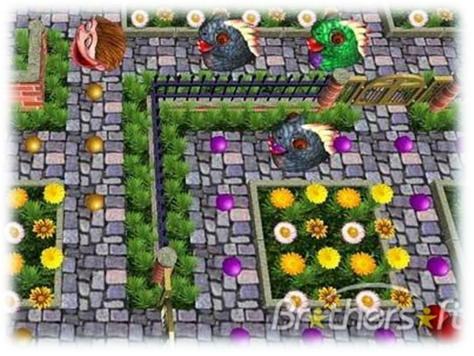
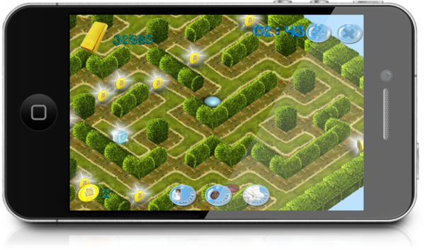
Artwork
Notes:
Cooper

Slide 12
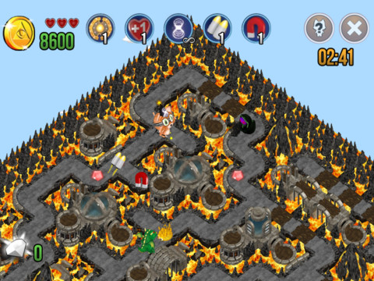
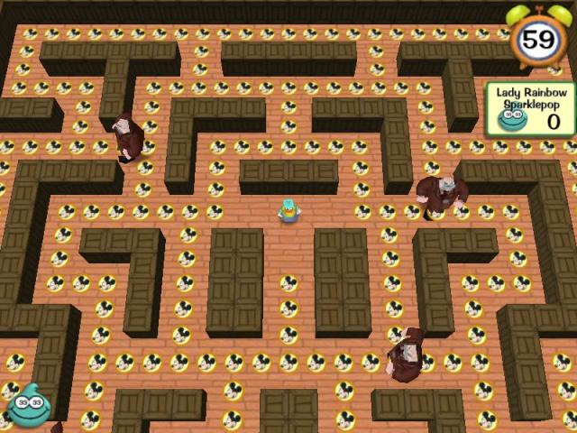
Artwork
Notes:
Cooper

Slide 13
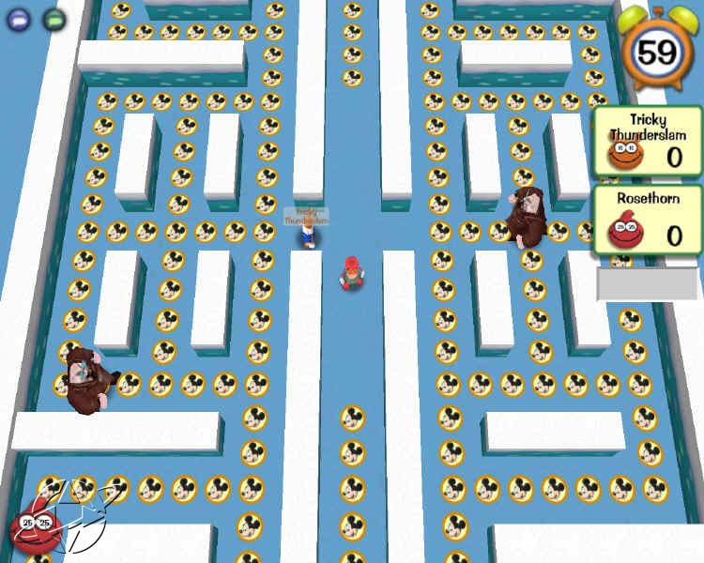
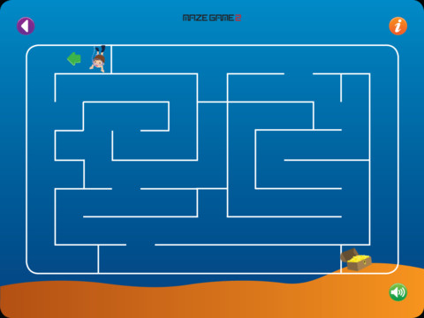
Artwork
Notes:
Cooper

Slide 14
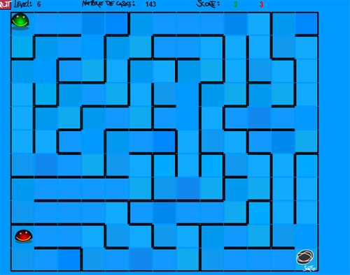
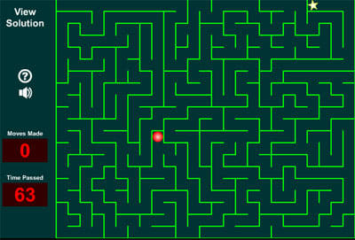
Artwork
Different Levels of Difficulty
Notes:
Cooper

Slide 15
Proposed Cost of App
Basic-Version cost: $.99-
Includes- 20 mazes for each difficulty
Pro-Version cost: $1.99-
Includes- 75 mazes for each difficulty
Power Up Pack cost: $.99-
Includes- 2 Longer Time, 2 Freeze Time, and 2 Direction Hints
Notes:
Ira: OK. But be prepared to get a question about free to play, or a free app that converts to a paid app.
Kevin

Slide 16
Projected Sales:
Projected 1 million game downloads and 50,000 power-ups first 6 months
Based on survey results and Advertising
Surveys administered through Ball Madness and Music Revolution over the past 2 weeks
Notes:
Ira: More information about how these are reasonable?
Kevin

Slide 17
Projected Sale Totals & Profit:
 | Purchases | Price per Unit | Profit
Pro- Version | 250,000 | $1.99 | $497,500
Basic – Version | 750,000 | $.99 | $742,500
Power-Up Package | 50,000 | $.99 | $49,500
Total | 1,050,000 | - | $1,289,500
Apple 30% | - | - | ($386,850)
Final Profit | - | - | $902,650
Development Cost + Advertising | - | - | ($300,000)
Investor Profit | - | - | $602,650
Notes:
Ira: I’d like to see a breakdown of how they got the $300K of dev cost, but this slide is useful to explain why the profit numbers are reasonable.
It’s not clear from “Investor Profit” if that would be going fully to the publisher, or if the game studio wants some of that money.
Kevin

Slide 18
Thank You!

